Slide 1
Unity for Scenario Visualization
Christopher Lum PhD lum@uw.edu
Madt Peck, Alum madtp@uw.edu
January 17, 2014

Slide 2
Method of Calling Data
Splice production code directly into Unity code
Too complex and time consuming
Not easy to repeat for each scenario
No way to pull the data directly from our production code

Slide 3
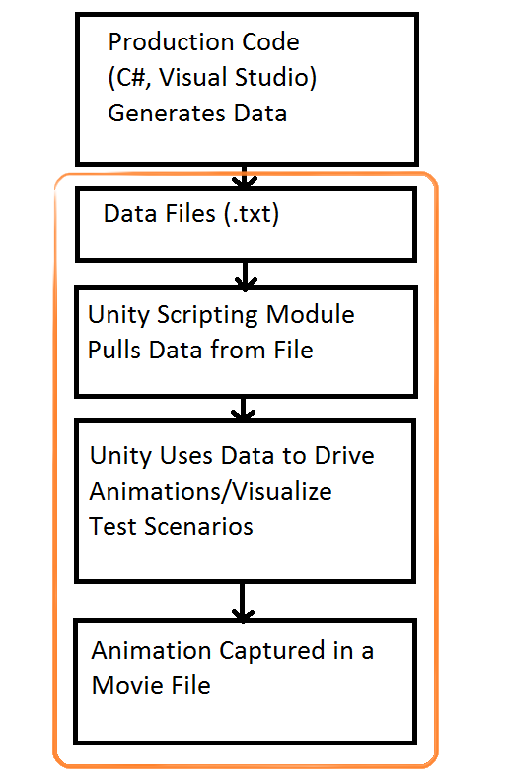
Scope of This User Story

Slide 4
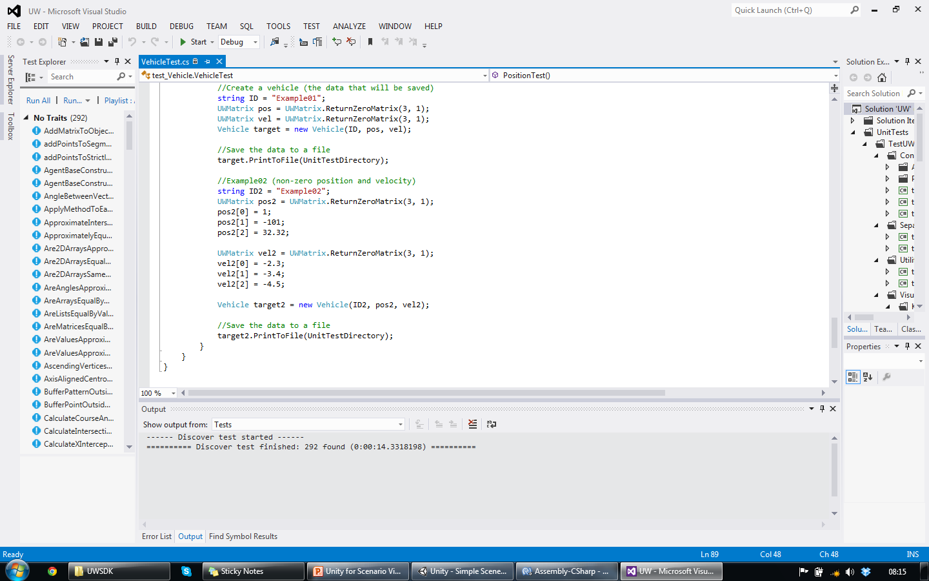
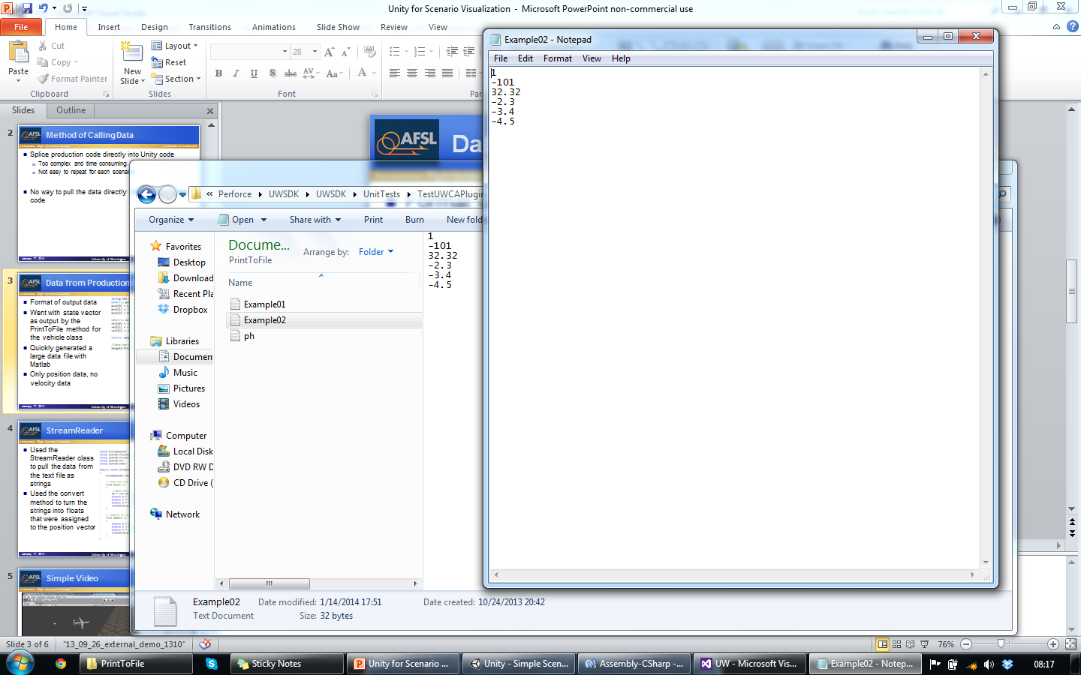
Data from Production Code
Format of output data
Went with state vector as output by the PrintToFile method for the vehicle class
Quickly generated a large data file with Matlab
Only position data, no velocity data

Slide 5
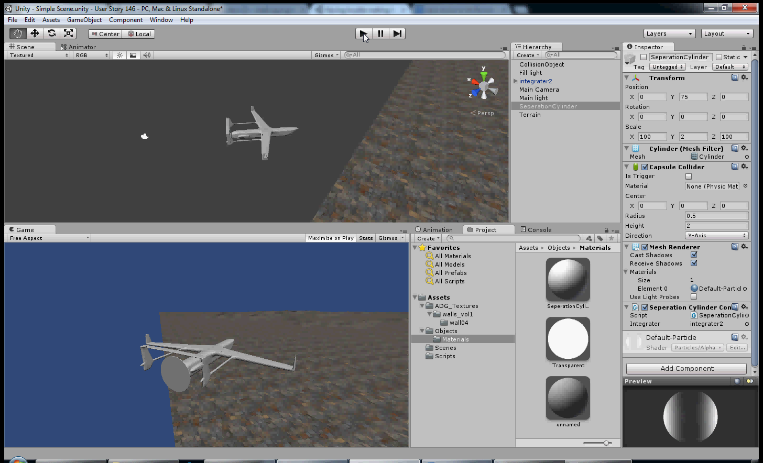
Simple Video
Notes:
Integrator that Robert made using Blender flying over simple terrain.

Slide 6
Next Sprint
Visualize separation cylinder and use external data to change its color
Import full state vector and display velocities on screen

